Slide 1
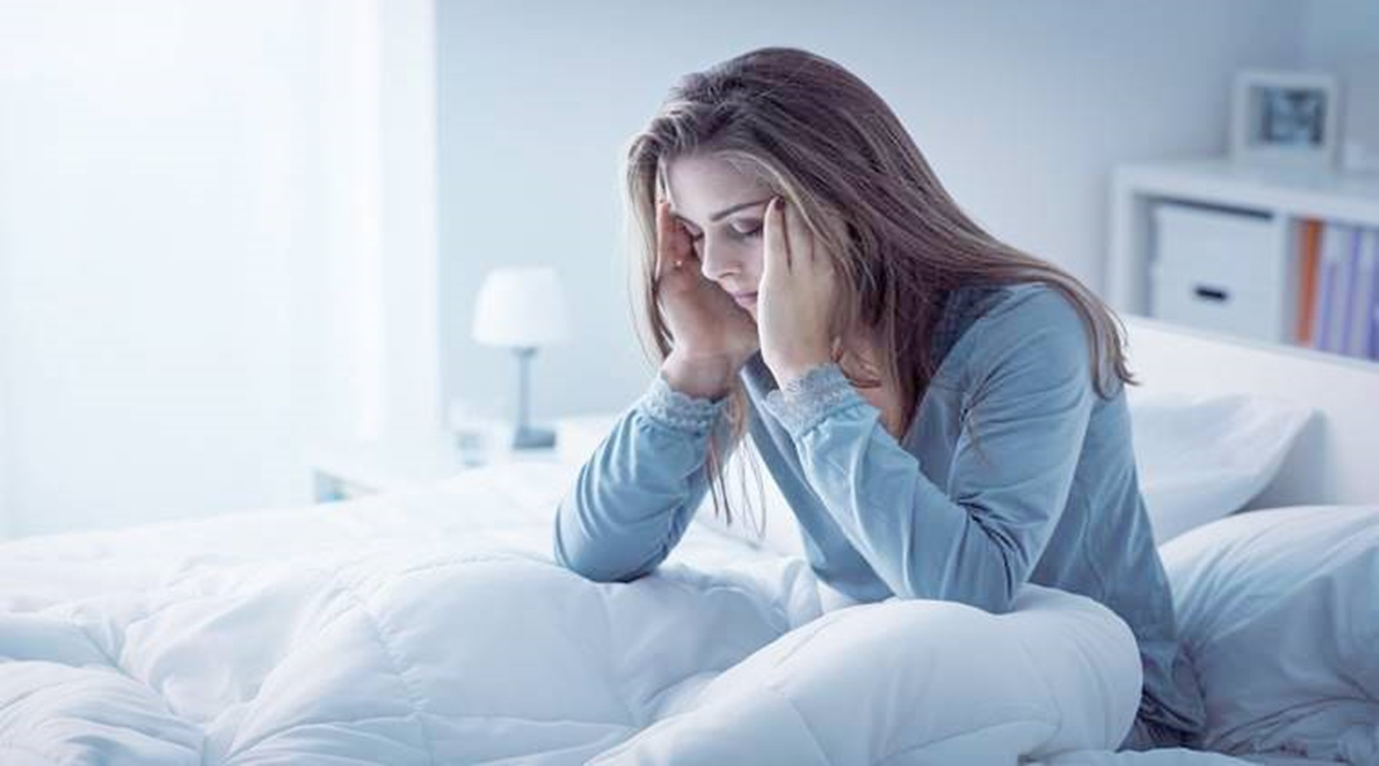
Sleep Efficiency Analysis and Modeling
Presented By:
Aditi Garg
Allison Potestio
Anusha Sekhar
Brendan Smith
Olesya Gaeva
Neha Changela
Susan Ombwayo
Rutgers University Data Analysis Bootcamp Final Project
December 14, 2023
Notes:
Allison

Slide 2
Our Data and Questions
Sleep Efficiency Dataset
Sleep efficiency dataset with 619 data rows based on research survey data
Columns include demographic information and sleep analysis information
Question to Address with ML Model
Can we use Machine Learning to predict what effect factors have on sleep quality?
Qualities to consider include gender, caffeine consumption, alcohol use, smoking status, exercise frequency
By identifying areas that directly impact sleep efficiency, we can help those looking to improve their quality of sleep
Github Repository
Notes:
Allison

Slide 3
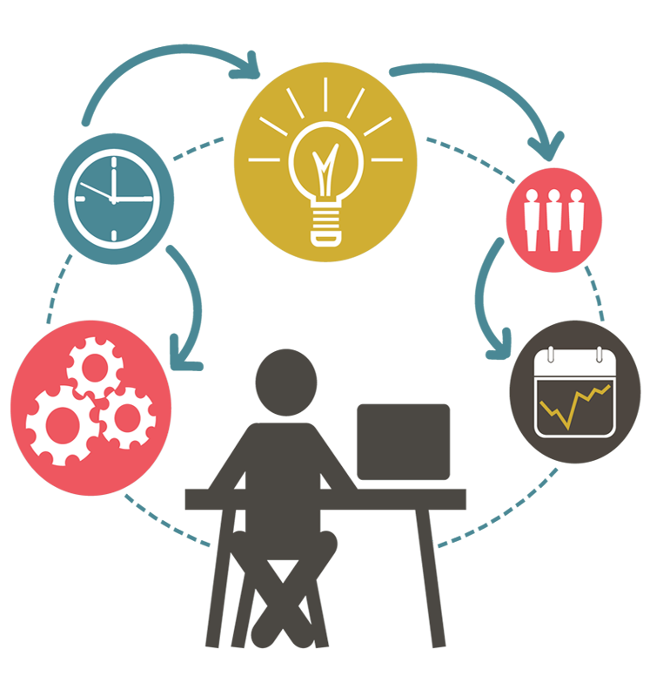
Project Overview
Machine Learning Models
TensorFlow
Logistic Regression
Data Analysis and Exploration
Pandas, Spark SQL
Visualizations
Tableau
Github Repository
Notes:
Allison

Slide 4
Data Preparation and Analysis
Refined model to increase accuracy by dropping null values
Accuracy is lower when null values are included
Attributes used to train model should be as accurate as possible
Classifying “good sleep”
85% or above sleep efficiency- best for model optimization
Data optimization to simplify analysis,improve visualizations, and allow us to create ML models
Get Dummies
Github Repository
Notes:
Brendan

Slide 5

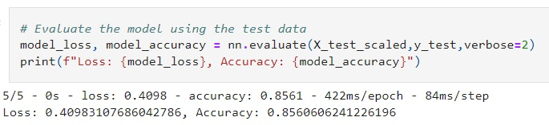
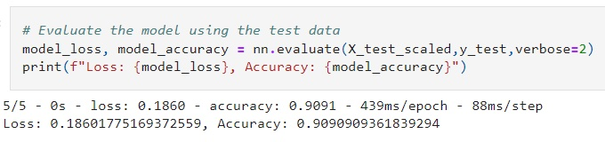
Machine Learning Models
Tensor Flow
Created model by running the dataset as is resulting in only 58% accuracy
Ran the model by dropping “Null” values, the result increased to a 85%
Optimized the model further by adding more neurons, the result increased to a 90%
Github Repository
Notes:
Brendan

Slide 6
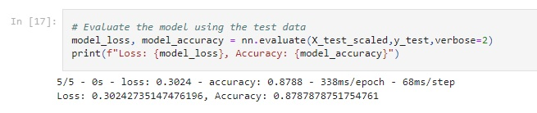

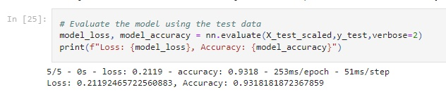
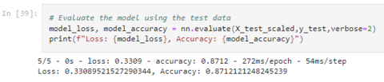
Machine Learning Models
Tensor Flow with various columns affecting Sleep Efficiency like Alcohol consumption, caffeine intake, Smoking status, Exercise frequency, with all the results being higher than 86%
Results by dropping “Alcohol consumption” column :
Results by dropping “Exercise frequency” column :
Results by dropping “Caffeine consumption” column :
Results by dropping “Smoking Status” column :
Github Repository
Notes:
Brendan

Slide 7
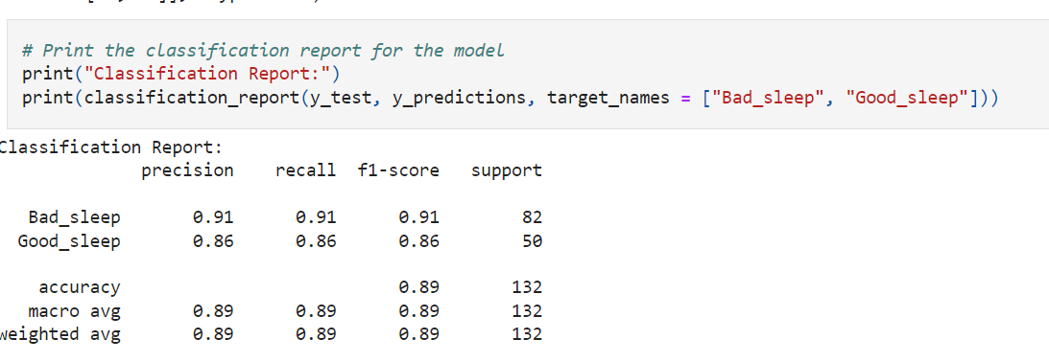
Machine Learning Models
Logistic Regression
Fit a logistic regression model by using the training data (X_train and y_train)
Use testing data to determine the accuracy of the model for predicting good sleep/ bad sleep
Our model had a 89% accuracy rating - both labels have a positive impact
Github Repository
Notes:
Olesya

Slide 8
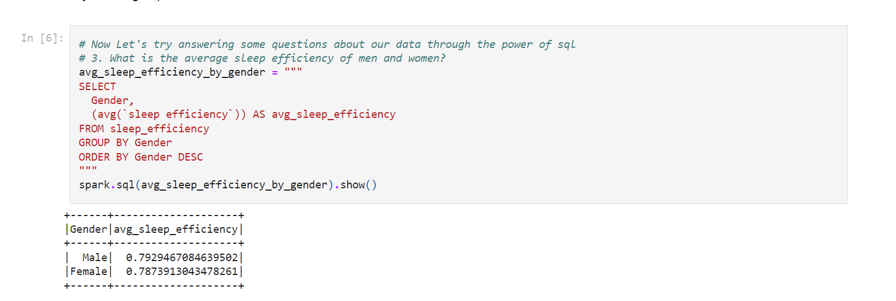
Spark SQL Analysis
Use analysis to help us understand data
Answer questions to help us learn about the data
Example: compare average sleep efficiency for males and females
79.2% for males, 78.7% for females
Github Repository
Notes:
Anusha

Slide 9
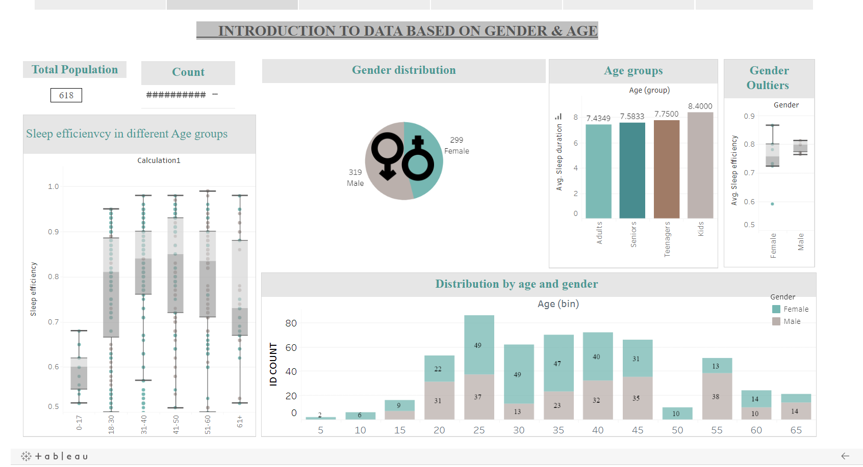
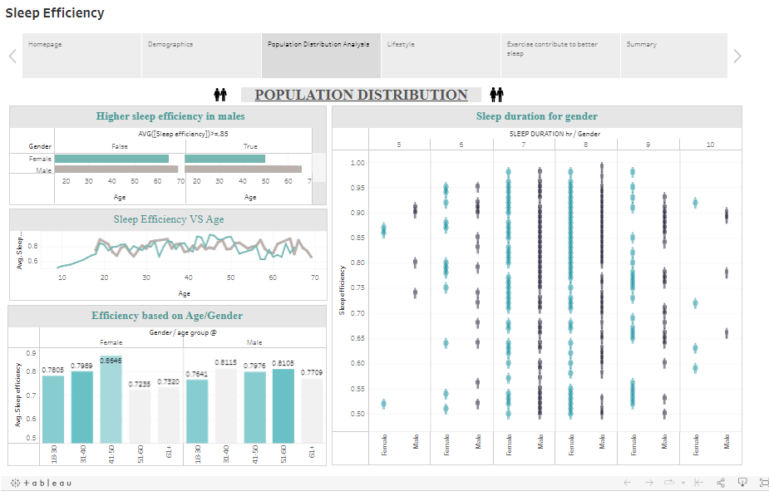
Tableau Visualizations
Tableau visualizations allowed us to determine relationship between demographic information and habits of participants and sleep efficiency
Tableau Story
Github Repository
Notes:
Aditi and Neha

Slide 10
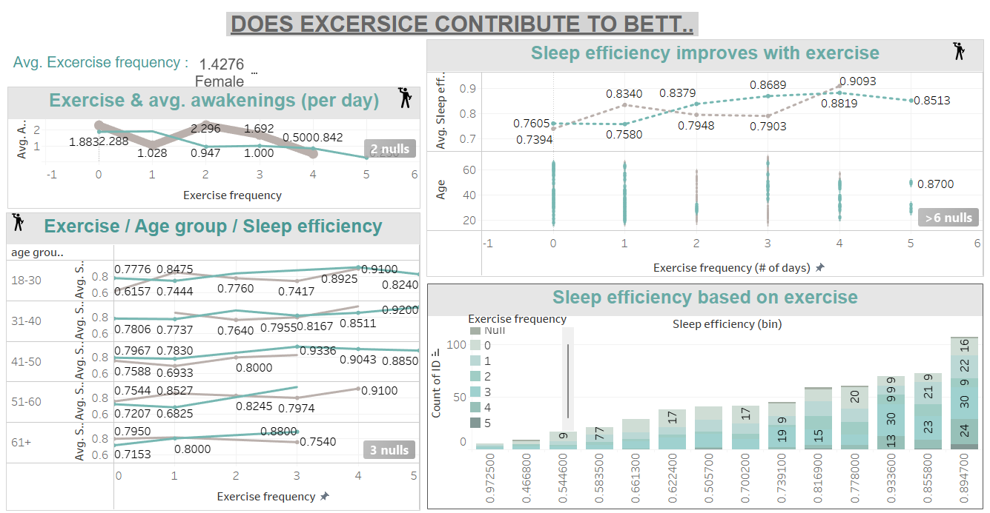
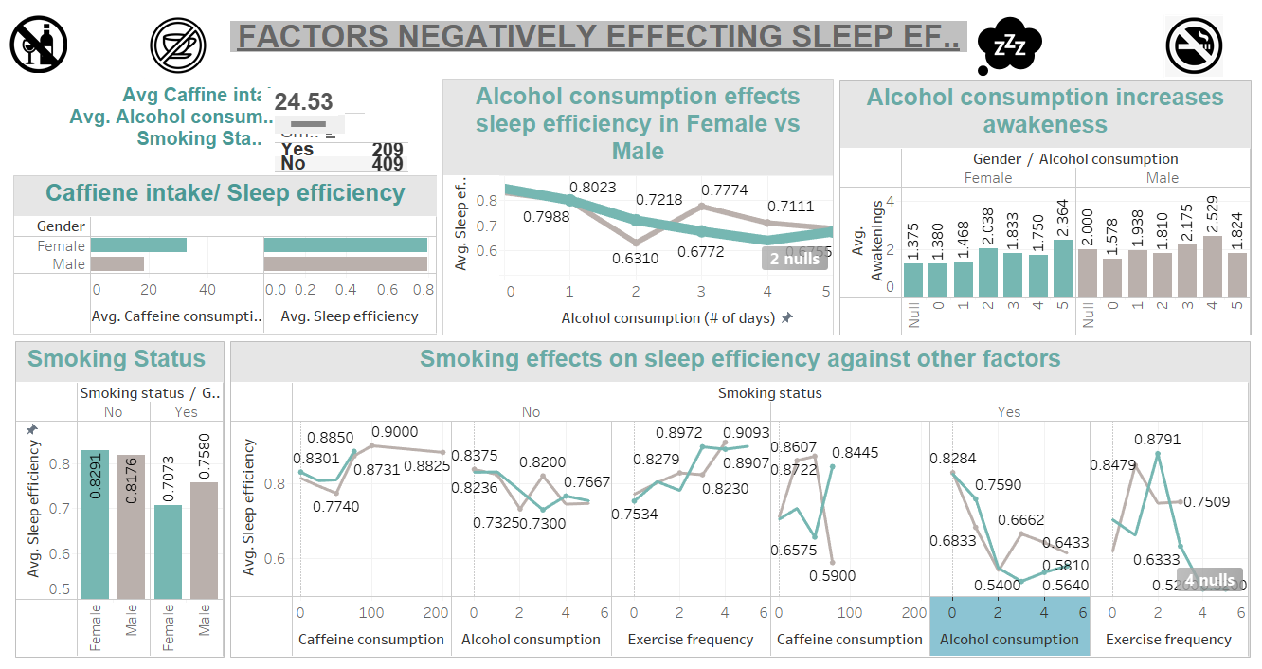
Tableau Visualizations
Tableau visualizations allowed us to determine lifestyle factors contribution affecting sleep efficiency
Tableau Story
Github Repository
Notes:
Aditi and Neha

Slide 11
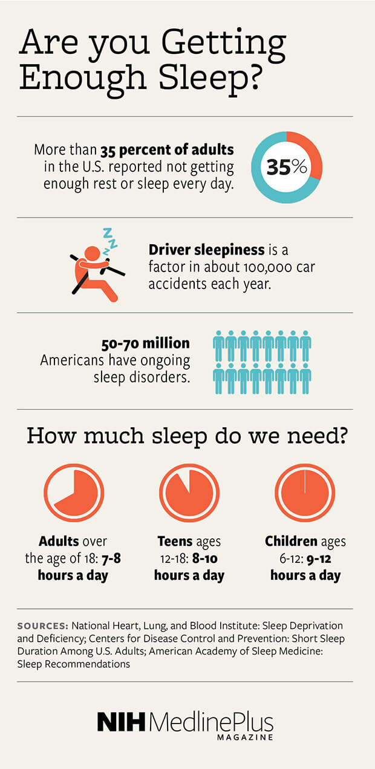
Processes and Problems
Testing on multiple datasets
400 rows vs 619 rows - increased accuracy in larger dataset
Removing null values to improve model accuracy
Model Optimization:
Deciding which models are best
50 epochs - determined this was best for efficiency and accuracy
Github Repository
Notes:
Susan/ Aditi

Slide 12
Analysis and Takeaways
Machine Learning Models : demographic information and habits affect and predict sleep efficiency
Tableau Visualizations : Allows us to see relationship between demographics and habits and sleep quality
Outliers : impacted our data analysis. For visualization purposes, with the exception of the Box Plot, we excluded outliers
Our model had the best accuracy when run with maximum attributes as available in the data set
Removing even a few rows containing null values had a high impact on the Model's efficiency
We found interesting trends while analyzing and visualizing the impact of habits on sleep efficiency by gender
Github Repository
Notes:
Susan

Slide 13
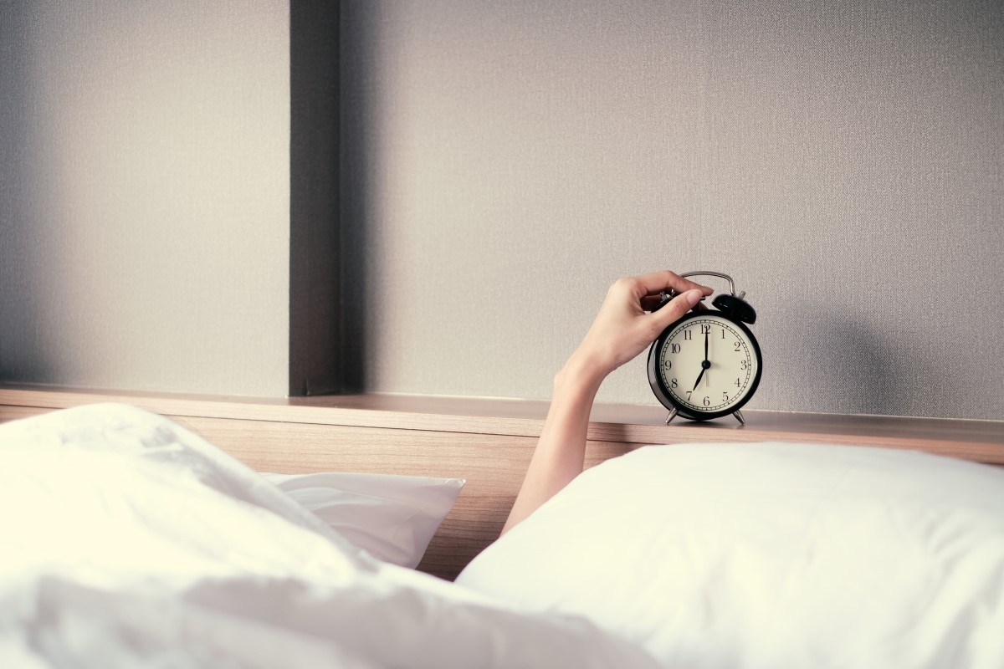
Conclusion
Thank you for listening to our presentation! Any questions?
Presented By:
Aditi Garg
Allison Potestio
Anusha Sekhar
Brendan Smith
Olesya Gaeva
Neha Changela
Susan Ombwayo
Github Repository

